Slide 1
W
E
L
C
O
M
E
Advanced Excel
Project Evaluation

Slide 2
About Me
Salil Narvekar
Educational Background - BSc.IT
Masters in Data Sci. & Analytics
Analyzing Clothing Store’s dataset

Slide 3
Import file type Excel (xlsx)
Data set source: Chart GPT prompting
Clothing Store
Dataset details:
Describes the annual sale of the clothing store in the year 2024
It contains the order-based records with respect to Gender, Age, Region, Order date, Clothing type, Size, Quantity, Mode of payment, etc.
It contains 500 + records
Reason for choosing:
Diverse dataset
Contains a Time-series data
Has Categorical as well as Quantified values
Addresses a real-world shopping trend scenario

Slide 4




OBJECTIVES
B
C
D
A
Data Cleaning
- Replacing blank values
- Correcting Data formats
- Rounding of decimals
- Removing unwanted column
- Formulating calculations
- Replacing respective values
Size Demand
- Which Size is sold most
- In which Gender
- In which region
- Of which clothing type
Seasonal Sales
- Season with least sale
- Season with highest sale
- Seasonal sale WRT region
- Sale WRT Clothing type
Regional Analysis
- Regional performance
- Region with highest sales
- Region with lowest sales
- WRT Gender & Clothing type
of the analysis

Slide 5


Four
F
A
B
C
D
E
Best Sellers
- Analyze Clothing types Sales
- Which is the Best seller
- Which is the Least seller
- In which region
- In which season
- WRT gender
Data Cleaning
- Replacing blank values
- Correcting Data formats
- Rounding of decimals
- Removing unwanted column
- Formulating calculations
- Replacing respective values
Total Revenue
- Find Total Revenue
- In the Year 2024
- Uptrend / downtrend
- WRT Seasons
- WRT Regions
- WRT the Clothing type
Size Demand
- Which Size is sold most
- In which Gender
- In which region
- Of which clothing type
Seasonal Sales
- Season with least sale
- Season with highest sale
- Seasonal sale WRT region
- Sale WRT Clothing type
Regional Analysis
- Regional performance
- Region with highest sales
- Region with lowest sales
- WRT Gender & Clothing type
Steps

Slide 6
E
F
Best Sellers
- Analyze Clothing types Sales
- Which is the Best seller
- Which is the Least seller
- In which region
- In which season
- WRT gender
Total Revenue
- Find Total Revenue
- In the Year 2024
- Uptrend / downtrend
- WRT Seasons
- WRT Regions
- WRT the Clothing type

Slide 7
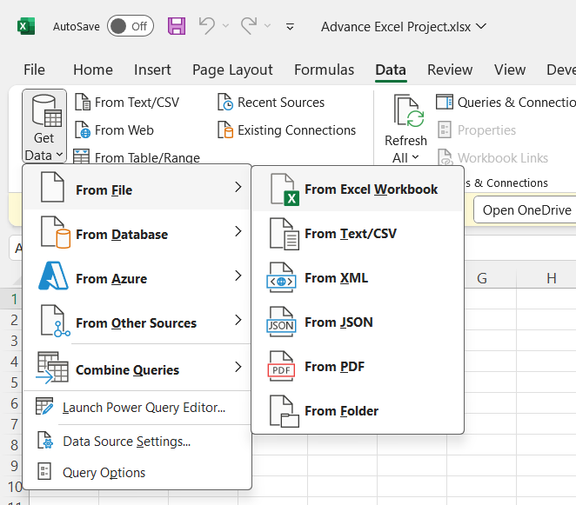
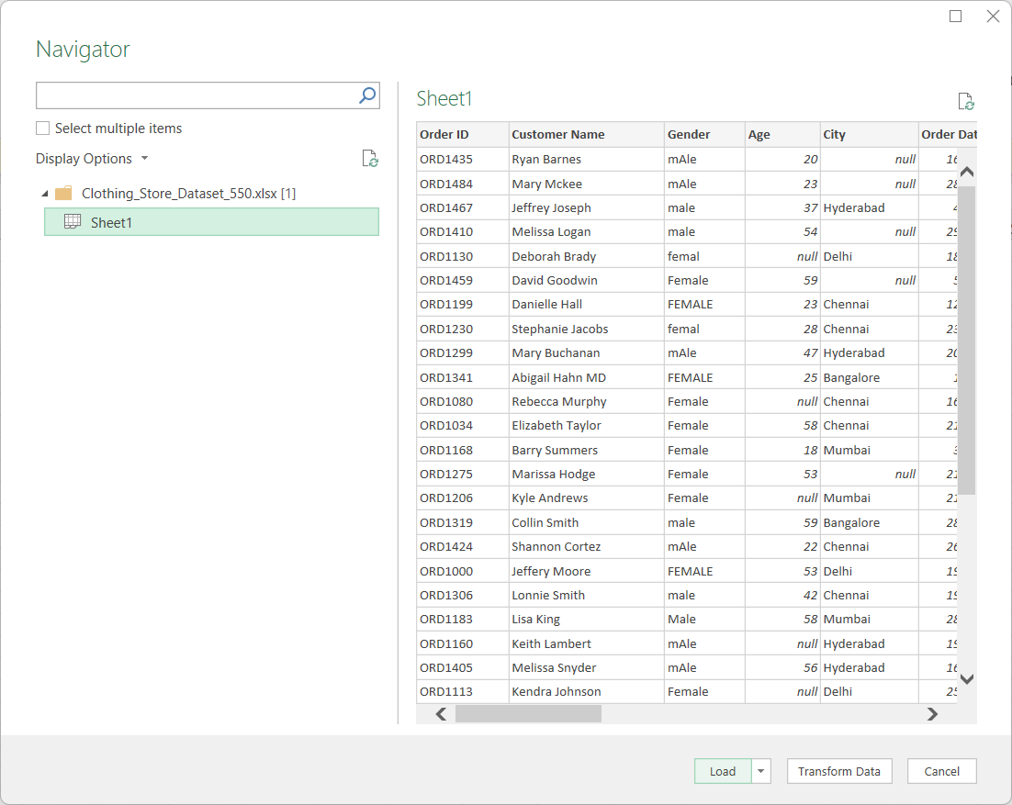
A - Data Cleaning & Transformation
F
E
Imported & loaded the Dataset’s Excel file from the Data tab > Get data
Best Sellers
- Analyze Clothing types Sales
- Which is the Best seller
- Which is the Least seller
- In which region
- In which season
- WRT gender
Total Revenue
- Find Total Revenue
- In the Year 2024
- Uptrend / downtrend
- WRT Seasons
- WRT Regions
- WRT the Clothing type

Slide 8
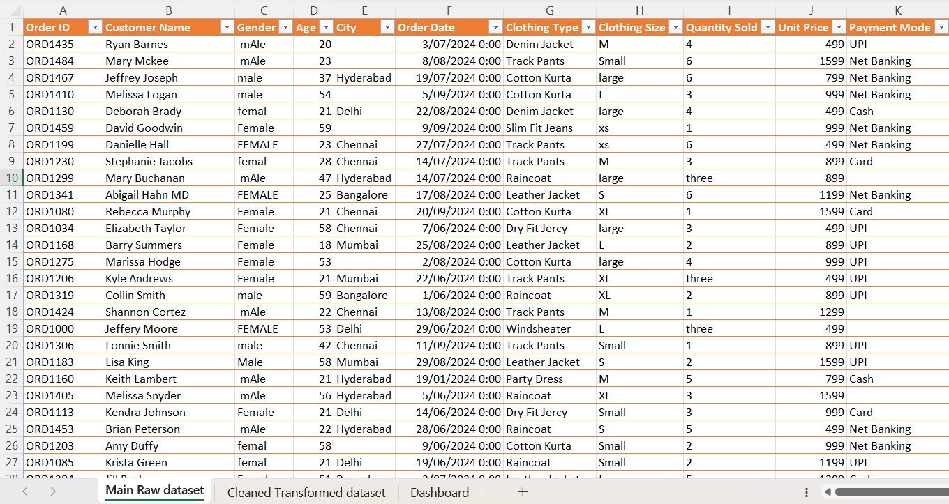
Raw Data set Snippet

Slide 9
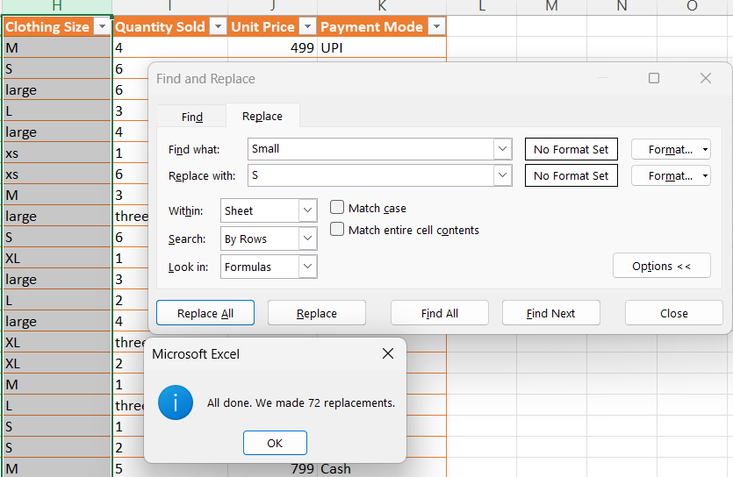
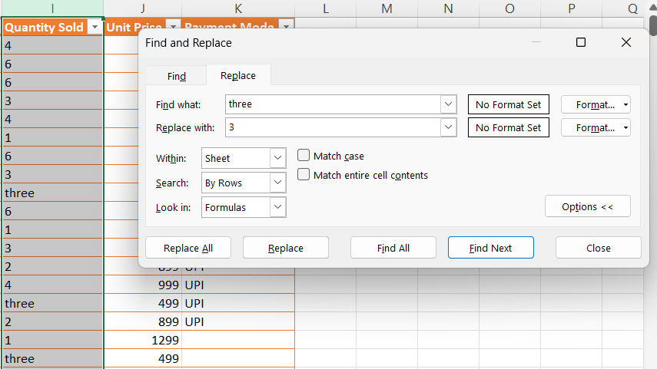
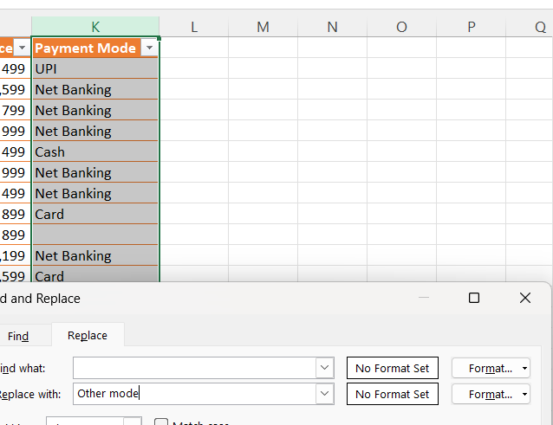
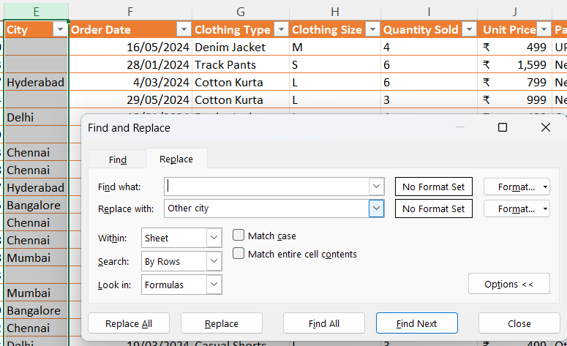
Initially, I Removed the Blank / Null values as “Others” & replaced the human error values by Ctrl + H

Slide 10
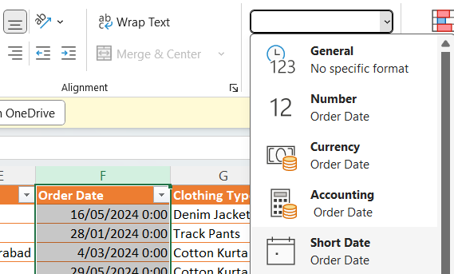
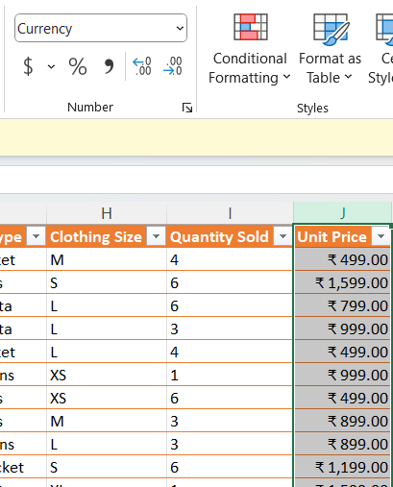
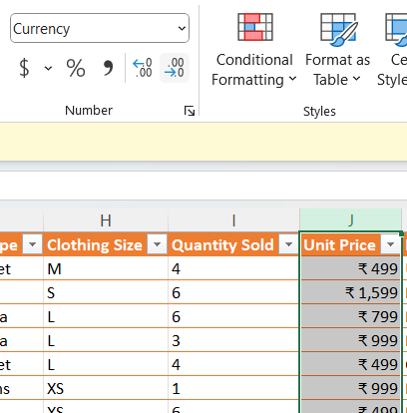
Also, I rechecked the data type formats of the columns & made respective changes Home > Number formats
[Age] & [Quantity Sold] columns into Number
[Order Date] into Short Date
Rounding of the values
[Unit Price] into Currency (Rupees)

Slide 11
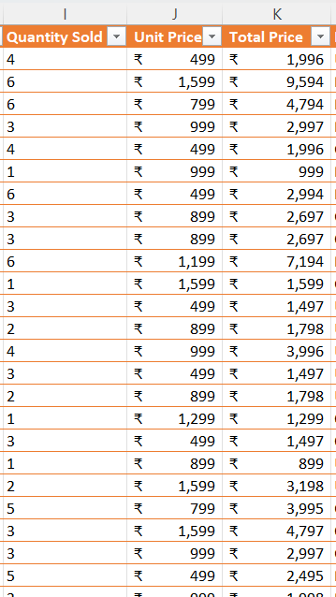

Created the Column for “Total Price” as “[Quantity Sold] * [Unit Price]”

Slide 12
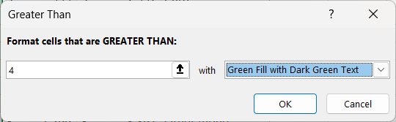
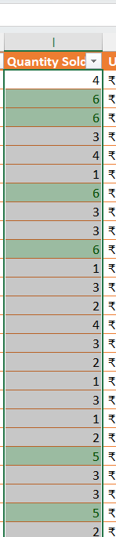
Applied Conditional Formatting on “Quantity Sold” column as highlight cell if the [Quantity Sold] > 4

Slide 13
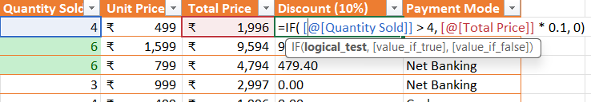

Created the Discount column with a condition that “[Quantity Sold] > 4” then 10% discount
Now based upon the discounted amount created the new column as “Final Payable Amount”
… And converted into the Rupees format

Slide 14
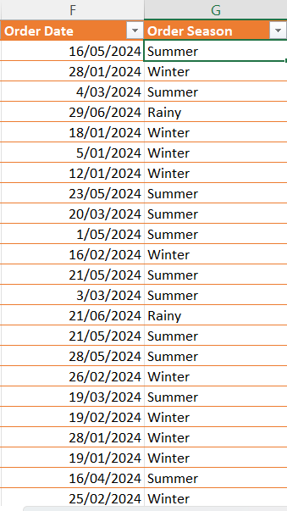
In order to create a “Purchase Season” column I created a column & coded a Nested-If condition to get the season based upon the month of the “Order Date” by using MONTH() function
Formula Bar in detail:
=IF(
OR(MONTH([@[Order Date]])=3, MONTH([@[Order Date]])=4, MONTH([@[Order Date]])=5), "Summer",
IF(
OR(MONTH([@[Order Date]])=6, MONTH([@[Order Date]])=7, MONTH([@[Order Date]])=8), "Rainy",
"Winter"))

Slide 15
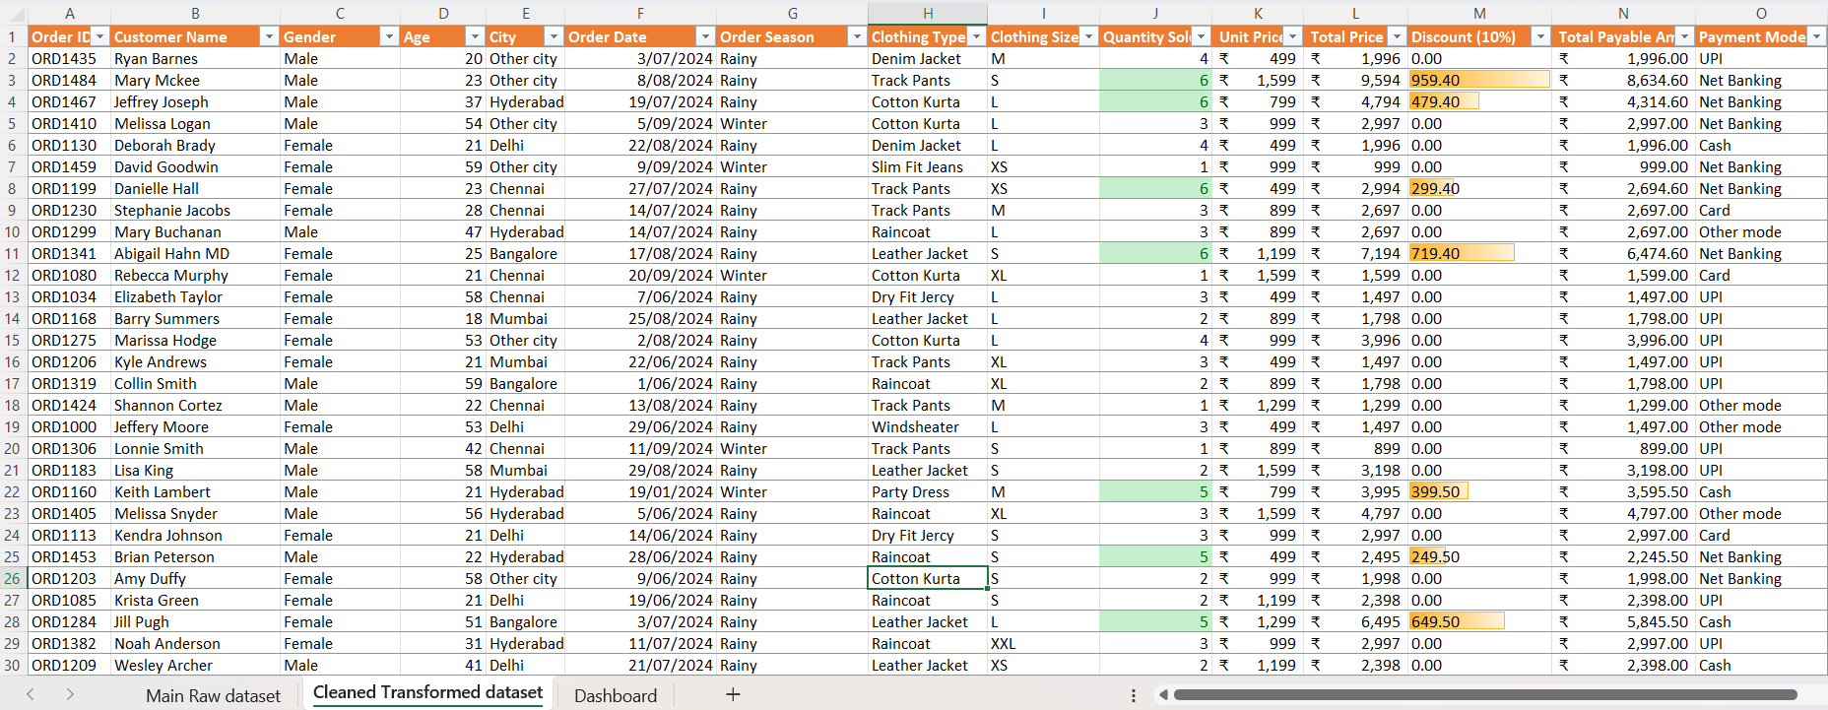
Final Cleaned & Transformed dataset

Slide 16
Now let us view Objective wise Analysis
I have made use of Pivot table & Pivot charts to represent the analysis reports
Made it more dynamic using Slicers
Additionally, have given the conditional formatting (color scale) to the identify the quantified values
And used Macros for Navigation purpose

Slide 17
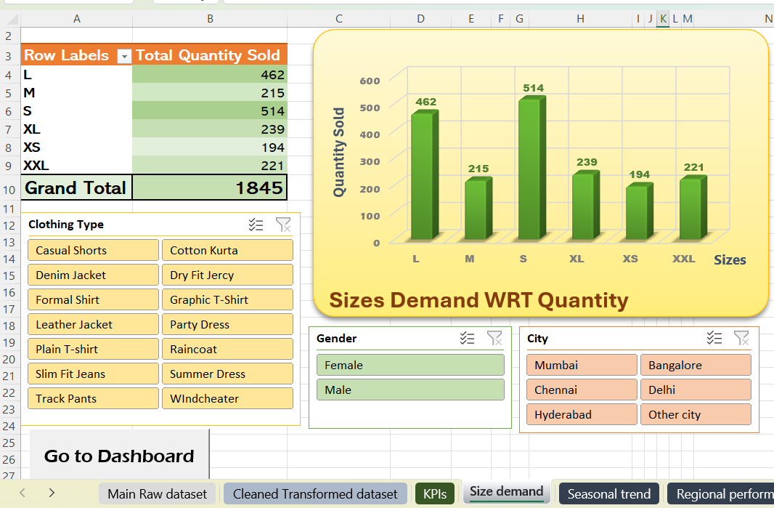
B - Size Demand Analysis
WRT
Customer’s Gender
Customer’s City
Clothing type

Slide 18
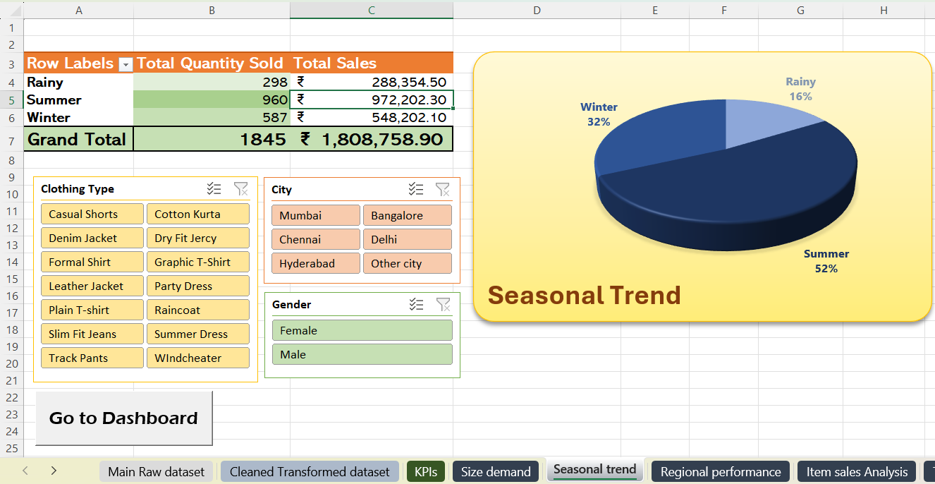
C - Seasonal Sales Trend Analysis
WRT
Customer’s Gender
Customer’s City
Clothing type

Slide 19
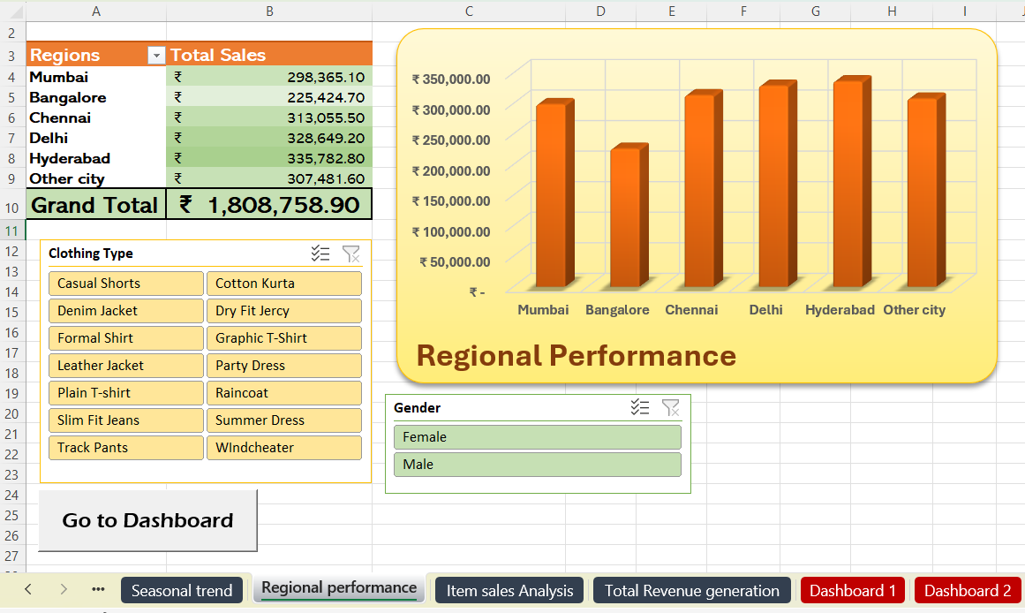
D - Regional Performance Analysis
WRT
Customer’s Gender
Clothing type

Slide 20
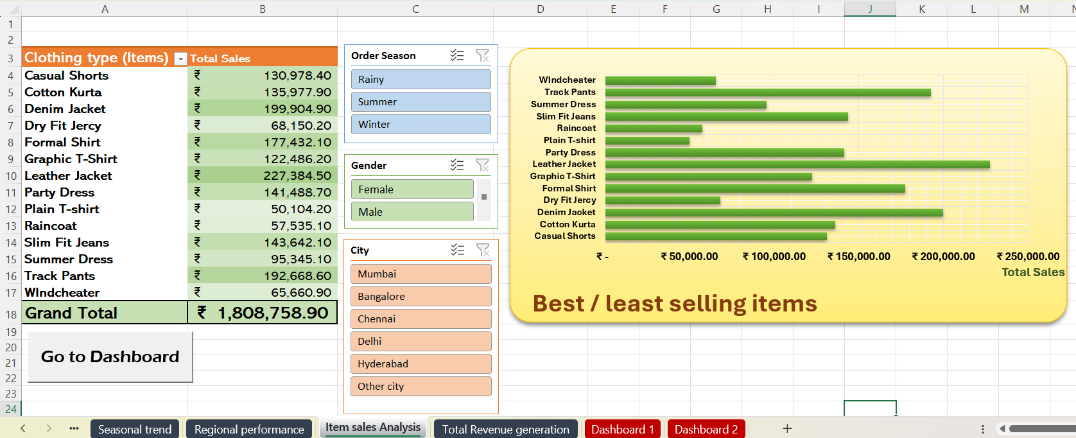
E - Best / Least Seller Analysis
WRT
Customer’s Gender
Customer’s City
Clothing type

Slide 21
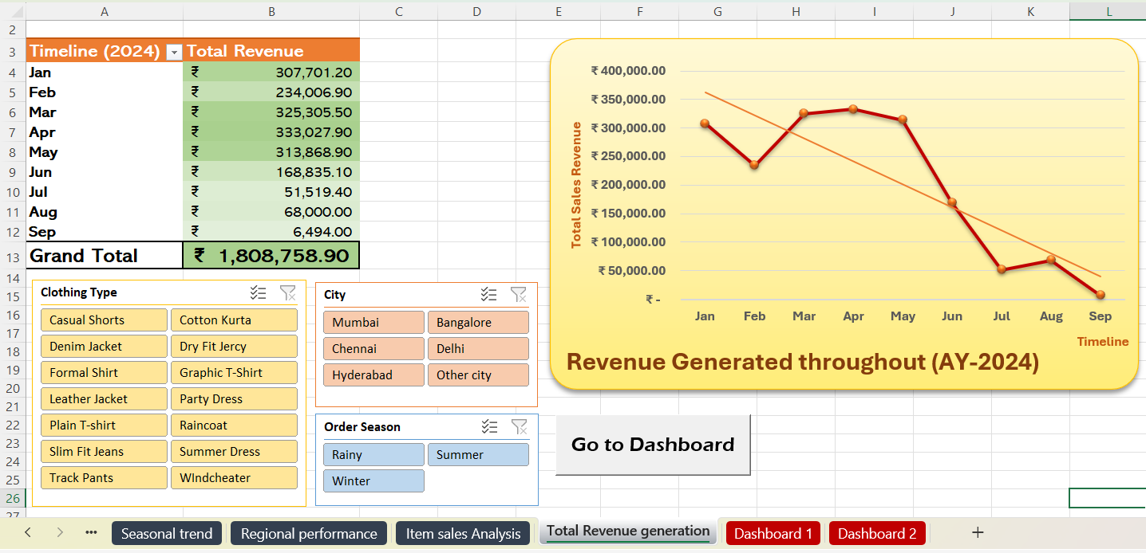
F - Total Revenue Analysis
WRT
Customer’s Gender
Customer’s City
Clothing type

Slide 22
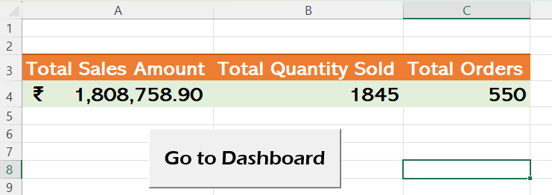
KPI - Key Performance Indicators
Total Sales Amount
Total Quantity Sold
Total Orders

Slide 23
SUMMARY & SOLUTIONS
B
C
D
Size Demand
Summary
Most sold size: Small
Least sold size: XS
Solution
Increase the production & In-stock availability of the most sold sizes in all the stores of the regions
Seasonal Trend
Summary
Least sales: Rainy
High sales: Summer
Solution
Add on some variety of Rainy wears in production
Since the varieties of rainy wears are comparatively less, Hence Sale in Rainy season is less
Regional Analysis
Summary
Least sales: Bangalore
High sales: Hyderabad
Solution
Do more marketing in Bangalore city / include the clothing trend of the city
of the analysis

Slide 24
Four
F
E
B
C
D
of the analysis
Total Revenue
Summary
Least in: Rainy
Highest in: Summers
Solution
Revenue is high in Mar, April & May & low in June, July, Aug & Sept. Consider previous solutions, to boost the revenue
Best Seller
Summary
Best seller: Jackets
Least: Plain T-shirt
Solution
Increase Jacket varieties & production (to prevent stock-out)
Improve the quality of plain t-shirts
Size Demand
Summary
Most sold size: Small
Least sold size: XS
Solution
Increase the production & In-stock availability of the most sold sizes in all the stores of the regions
Seasonal Trend
Summary
Least sales: Rainy
High sales: Summer
Solution
Add on some variety of Rainy wears in production
Since the varieties of rainy wears are comparatively less, Hence Sale in Rainy season is less
Regional Analysis
Summary
Least sales: Bangalore
High sales: Hyderabad
Solution
Do more marketing in Bangalore city / include the clothing trend of the city
SUMMARY &
SOLUTIONS
Steps

Slide 25
E
F
of the analysis
Best Seller
Summary
Best seller: Jackets
Least: Plain T-shirt
Solution
Increase Jacket varieties & production (to prevent stock-out)
Improve the quality of plain t-shirts
Total Revenue
Summary
Least in: Rainy
Highest in: Summers
Solution
Revenue is high in Mar, April & May & low in June, July, Aug & Sept. Consider previous solutions, to boost the revenue
SUMMARY &
SOLUTIONS

Slide 26
Dashboard
E
F
of the analysis
Best Seller
Summary
Best seller: Jackets
Least: Plain T-shirt
Solution
Increase Jacket varieties & production (to prevent stock-out)
Improve the quality of plain t-shirts
Total Revenue
Summary
Least in: Rainy
Highest in: Summers
Solution
Revenue is high in Mar, April & May & low in June, July, Aug & Sept. Consider previous solutions, to boost the revenue
SUMMARY &
SOLUTIONS

Slide 27
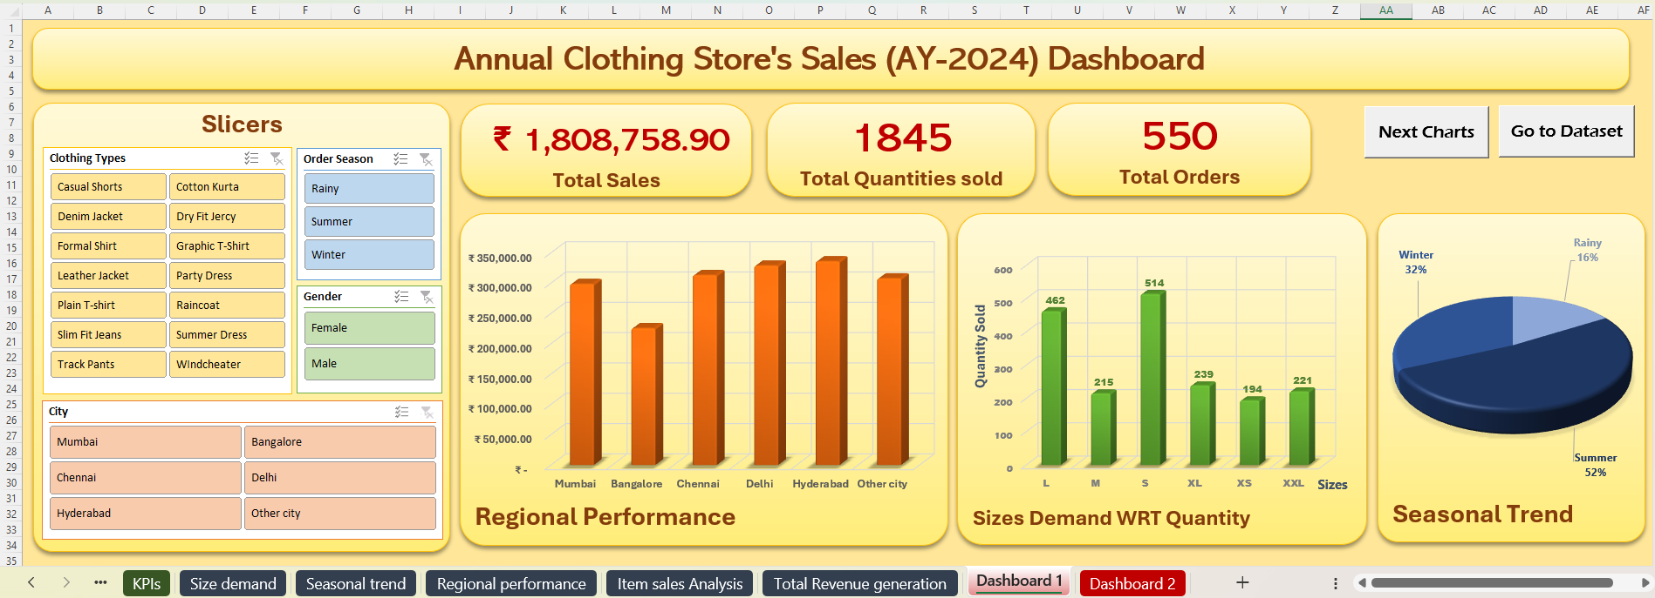
Dashboard Page 1

Slide 28
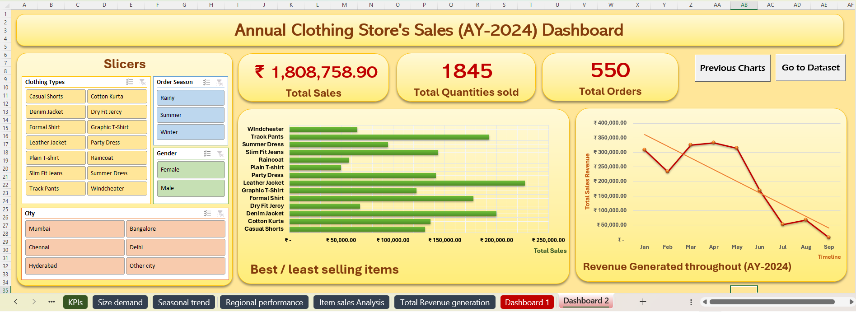
Dashboard Page 2

Slide 29
Thank You

